Slide 1
Comments App

Slide 2
Functionalities
Add, Update, Remove, View comments
Reply on comments/replies
Like/Dislike a comment/reply
View list of people who liked/disliked a comment/reply

Slide 3
Assumptions
User registration, authentication/authorization will be handled by separate service and is out of scope
For demo purpose userId will be passed in the header
Comments are visible to all users. i.e., no follower/followee concept
Deleting a comment does not delete the replies
Maximum size of a comment can be 1000 characters

Slide 4
Technologies used
Java, Spring Boot
PostgreSQL – (can be replaced by CockroachDB for scaling)
RabbitMQ – (can be replaced by Kafka for scaling)

Slide 5
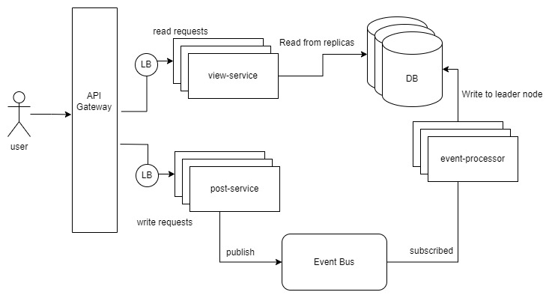
High level architecture

Slide 6
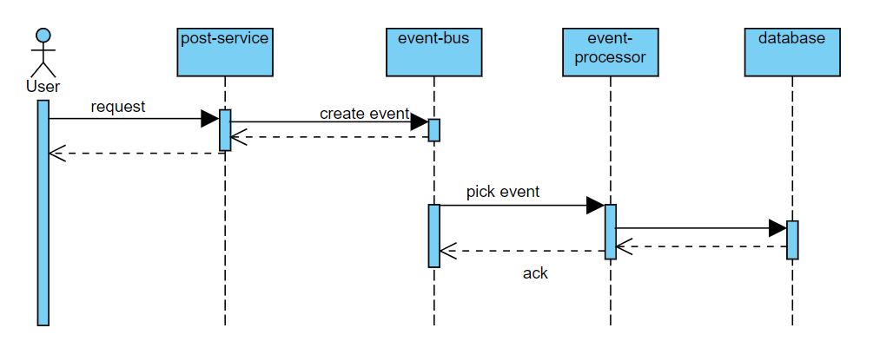
Event driven flow

Slide 7
APIs
post-service
/post-service/api/comments – POST
/post-service/api/comments – PUT
/post-service/api/comments – DELETE
/post-service/api/reactions – POST
view-service (paginated APIs)
/view-service/api/comments – GET
/view-service/api/comments/{parentId} - GET
/view-service/api/reactions/{commentId} - GET

Slide 8
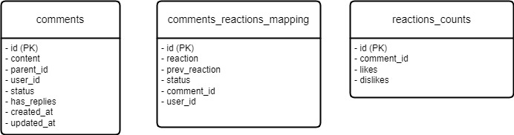
Database design
No foreign key constraints to make it extensible
A new column can be added in reactions_counts to add a new reaction-type.

Slide 9
Reaction Count Update
Reactions will be periodically calculated and updated
Flow:
1. user reacts to a comment
2. A new row in comments_reactions_mapping gets added with status = NEW
3. A schedular periodically locks a batch of rows where status = NEW, and update the count in reactions_counts

Slide 10
TODO / further improvements
Separate service to manage event bus
Logging and distributed tracing
Use Kafka instead of RabbiMQ
Use CockroachDB instead of PostgreSQL
Use Liquibase/Flyway to apply database schema changes
Schedular to move/cleanup old data to a file system
Service auto scaling, Rate limiting view requests/user

